Slide 1
elasticnet regression
Overview
Main ideas behind elasticnet regression
How it works
Situations where elasticnet regression works
Machine learning

Slide 2
What is LASSO regression?
the elastic net is a regularized regression method that linearly combines the L1 and L2 penalties of the lasso and ridge methods.
elastic net preferred over lasso & ridge regression because it solves the limitations of both methods
L1 Regularization aka Lasso Regularization– This add regularization terms in the model which are function of absolute value of the coefficients of parameters.
The coefficient of the parameters can be driven to zero as well during the regularization process.
Hence this technique can be used for feature selection
L2 Regularization aka Ridge Regularization — This add regularization terms in the model which are function of square of coefficients of parameters.
Coefficient of parameters can approach to zero but never become zero and hence

Slide 3
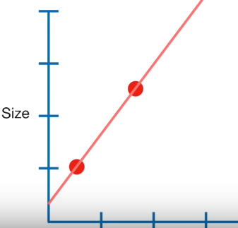

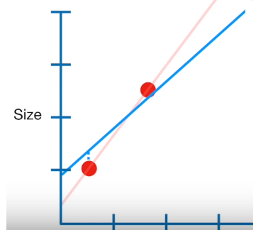
How LASSO regression works
When Lease Squares determines values for the parameters in the linear equation …
size = y-intercept + slope * weight
.. It minimizes The sum of the squared residuals
In contrast when LASSO Regression determines values for the parameters in the linear equation …
size = y-intercept + slope * weight
.. It minimizes … The sum of the squared residuals
plus * |slope|
penalty
Severity of penalty

Slide 4
Ridge vs lasso
Ridge Regression
size = y-intercept + slope * weight
.. It minimizes …
The sum of the squared residuals
plus * slope²
Works well when the model contains all the Xs which are useful
LASSO Regression
size = y-intercept + slope * weight
.. It minimizes …
The sum of the squared residuals
plus * |slope|
Works best when the model contains useless variables

Slide 5
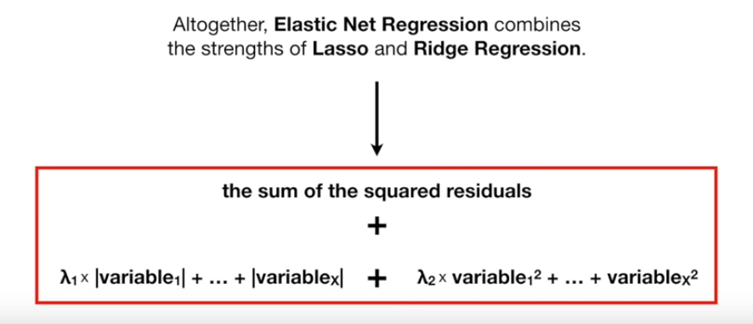
How does elasticnet work
Works well in case of colinear Xs
In case of correlated features, lasso picks up only 1 and drops the other

Slide 6
Best lambda1 and lambda2

